Slide 1

Desarrollo Funcional
Grupo 6
Sección 1
Juan Pablo Contreras
Rodrigo Heiremans
Matias Perez

Slide 2

Funcionamiento General

Slide 3
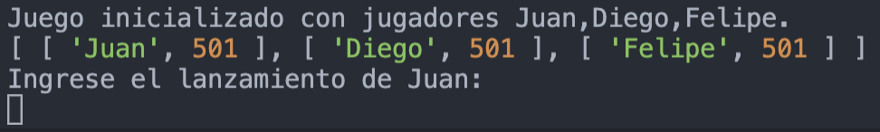
Inicio del juego
Los nombres de los jugadores son declarados en el código de la función y pueden ser 2 o más

Slide 4

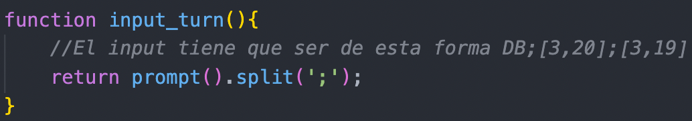
Recepción de input

Slide 5
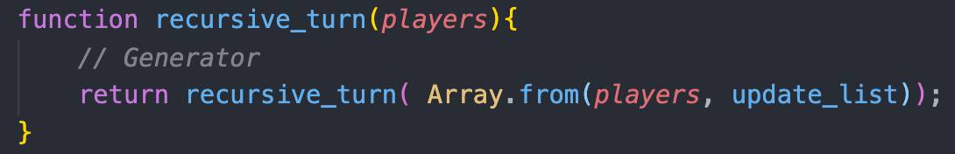
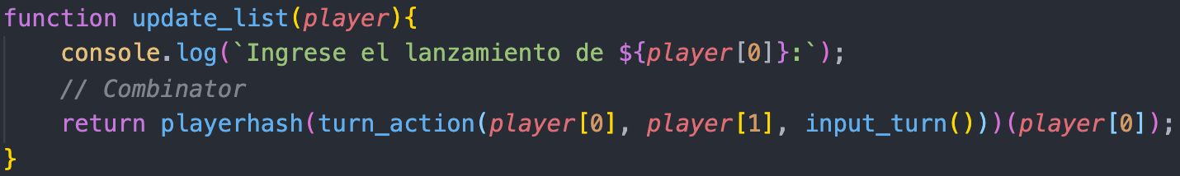
Recursión para las rondas
Para cada ronda, se corre una función sobre la lista de jugadores que actualizará sus puntajes respectivos, creando una nueva lista con los nuevos resultados permanentemente hasta que exista un ganador.

Slide 6
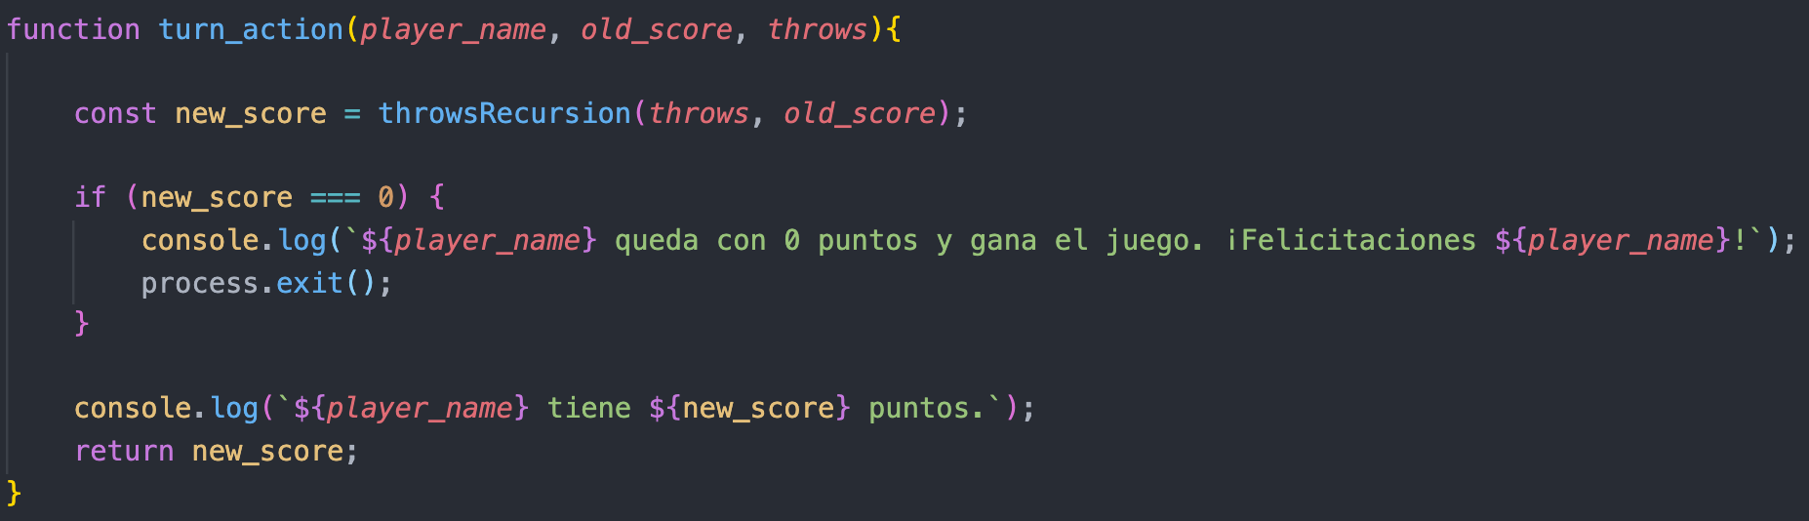
Turno
Se calcula el nuevo puntaje para el jugador luego de haber hecho sus 3 lanzamientos. En caso de ganar el juego, se acaba el programa

Slide 7
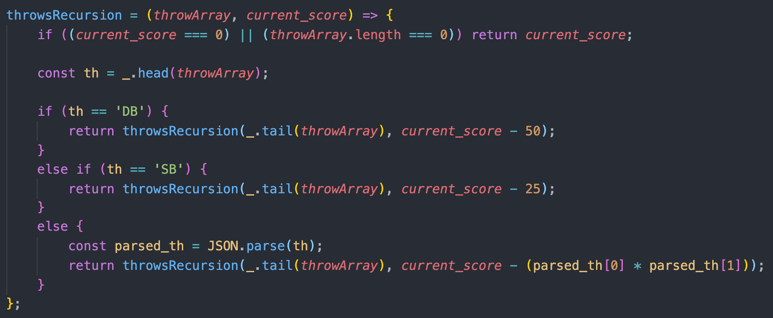
Recursión para los lanzamientos

Slide 8
Lanzamiento

Slide 9
play_game()
recursive_turn()
init_game()
update_list()
input_turn()
player_hash501()
turn_action()
player_hash()
throws_recursion()
play_game("Juan", "Diego","Felipe")

Slide 10
play_game()
recursive_turn()
init_game()
update_list()
input_turn()
player_hash501()
turn_action()
player_hash()
throws_recursion()
play_game("Juan", "Diego","Felipe")

Slide 11
play_game()
recursive_turn()
init_game()
update_list()
input_turn()
player_hash501()
turn_action()
player_hash()
throws_recursion()
play_game("Juan", "Diego","Felipe")

Slide 12
play_game()
recursive_turn()
init_game()
update_list()
input_turn()
player_hash501()
turn_action()
player_hash()
throws_recursion()
play_game("Juan", "Diego","Felipe")

Slide 13
play_game()
recursive_turn()
init_game()
update_list()
input_turn()
player_hash501()
turn_action()
player_hash()
throws_recursion()
play_game("Juan", "Diego","Felipe")

Slide 14
play_game()
recursive_turn()
init_game()
update_list()
input_turn()
player_hash501()
turn_action()
player_hash()
throws_recursion()
play_game("Juan", "Diego","Felipe")
players (lista de listas)

Slide 15
play_game()
recursive_turn()
init_game()
update_list()
input_turn()
player_hash501()
turn_action()
player_hash()
throws_recursion()
play_game("Juan", "Diego","Felipe")
Turno de juan

Slide 16
play_game()
recursive_turn()
init_game()
update_list()
input_turn()
player_hash501()
turn_action()
player_hash()
throws_recursion()
play_game("Juan", "Diego","Felipe")

Slide 17
play_game()
recursive_turn()
init_game()
update_list()
input_turn()
player_hash501()
turn_action()
player_hash()
throws_recursion()
play_game("Juan", "Diego","Felipe")

Slide 18
play_game()
recursive_turn()
init_game()
update_list()
input_turn()
player_hash501()
turn_action()
player_hash()
throws_recursion()
play_game("Juan", "Diego","Felipe")
throws

Slide 19
play_game()
recursive_turn()
init_game()
update_list()
input_turn()
player_hash501()
turn_action()
player_hash()
throws_recursion()
play_game("Juan", "Diego","Felipe")
1

Slide 20
play_game()
recursive_turn()
init_game()
update_list()
input_turn()
player_hash501()
turn_action()
player_hash()
throws_recursion()
play_game("Juan", "Diego","Felipe")
2

Slide 21
play_game()
recursive_turn()
init_game()
update_list()
input_turn()
player_hash501()
turn_action()
player_hash()
throws_recursion()
play_game("Juan", "Diego","Felipe")
3

Slide 22
play_game()
recursive_turn()
init_game()
update_list()
input_turn()
player_hash501()
turn_action()
player_hash()
throws_recursion()
play_game("Juan", "Diego","Felipe")

Slide 23
play_game()
recursive_turn()
init_game()
update_list()
input_turn()
player_hash501()
turn_action()
player_hash()
throws_recursion()
play_game("Juan", "Diego","Felipe")
new_score

Slide 24
play_game()
recursive_turn()
init_game()
update_list()
input_turn()
player_hash501()
turn_action()
player_hash()
throws_recursion()
play_game("Juan", "Diego","Felipe")

Slide 25
play_game()
recursive_turn()
init_game()
update_list()
input_turn()
player_hash501()
turn_action()
player_hash()
throws_recursion()
play_game("Juan", "Diego","Felipe")
Turno de diego

Slide 26
play_game()
recursive_turn()
init_game()
update_list()
input_turn()
player_hash501()
turn_action()
player_hash()
throws_recursion()
play_game("Juan", "Diego","Felipe")

Slide 27
play_game()
recursive_turn()
init_game()
update_list()
input_turn()
player_hash501()
turn_action()
player_hash()
throws_recursion()
play_game("Juan", "Diego","Felipe")

Slide 28
play_game()
recursive_turn()
init_game()
update_list()
input_turn()
player_hash501()
turn_action()
player_hash()
throws_recursion()
play_game("Juan", "Diego","Felipe")
throws

Slide 29
play_game()
recursive_turn()
init_game()
update_list()
input_turn()
player_hash501()
turn_action()
player_hash()
throws_recursion()
play_game("Juan", "Diego","Felipe")
1

Slide 30
play_game()
recursive_turn()
init_game()
update_list()
input_turn()
player_hash501()
turn_action()
player_hash()
throws_recursion()
play_game("Juan", "Diego","Felipe")
2

Slide 31
play_game()
recursive_turn()
init_game()
update_list()
input_turn()
player_hash501()
turn_action()
player_hash()
throws_recursion()
play_game("Juan", "Diego","Felipe")
3

Slide 32
play_game()
recursive_turn()
init_game()
update_list()
input_turn()
player_hash501()
turn_action()
player_hash()
throws_recursion()
play_game("Juan", "Diego","Felipe")

Slide 33
play_game()
recursive_turn()
init_game()
update_list()
input_turn()
player_hash501()
turn_action()
player_hash()
throws_recursion()
play_game("Juan", "Diego","Felipe")
new_score

Slide 34
play_game()
recursive_turn()
init_game()
update_list()
input_turn()
player_hash501()
turn_action()
player_hash()
throws_recursion()
play_game("Juan", "Diego","Felipe")

Slide 35
play_game()
recursive_turn()
init_game()
update_list()
input_turn()
player_hash501()
turn_action()
player_hash()
throws_recursion()
play_game("Juan", "Diego","Felipe")
Turno felipe

Slide 36
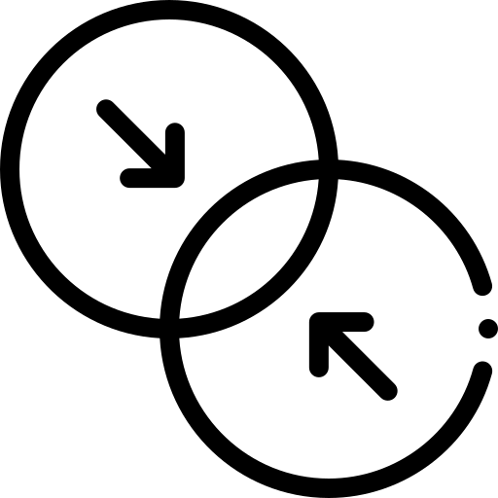
Combinator

Slide 37
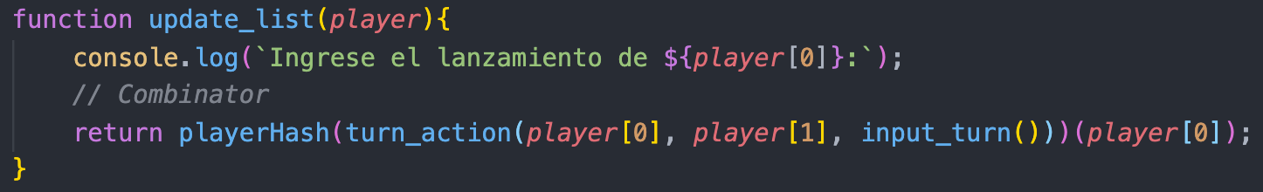
Dado que la función playerHash busca obtener el puntaje a continuación de recibir los inputs del lanzamiento, se le entrega como parámetro la función de calcular el puntaje que en sí recibe como parámetro la función para recibir los inputs del usuario.

Slide 38
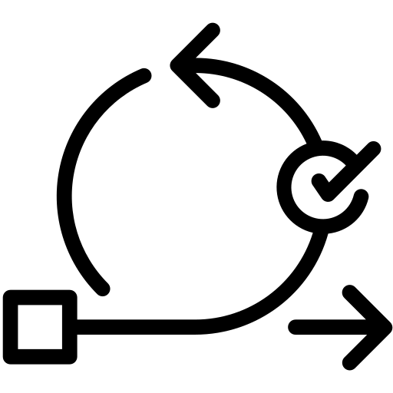
Iterators and Generators

Slide 39
Iterator
Input:
Output:

Slide 40
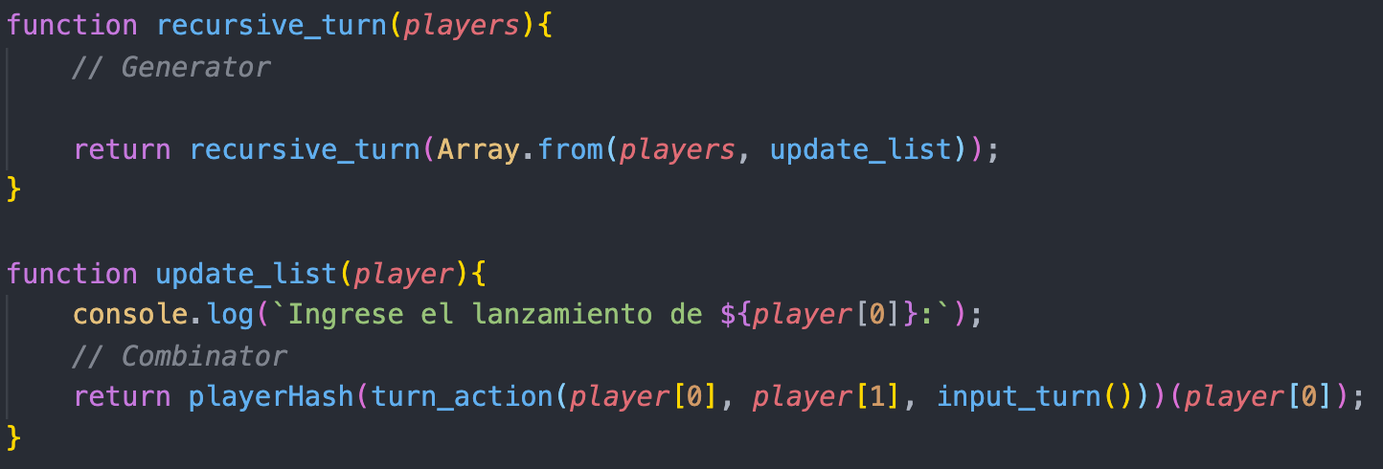
Generators

Slide 41
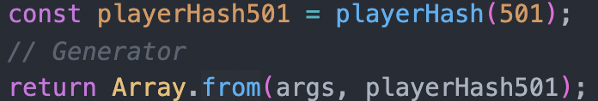
Generators

Slide 42

Lodash

Slide 44

Currying

Slide 45
